Slide 1

SRM INSTITUTE OF SCIENCE AND TECHNOLOGY
TEAM MEMBERS
BALAJEE E:
RA2311003020143
HARI V:
RA2311003020168
YASHWANTH R:
RA2311003020173
21CSC202J – Operating System
VIRTUAL MANAGEMENT SYSTEM
(ODD Sem 2024-2025)
BATCH 10
CSE C

Slide 2
ABSTRACT
This project presents a simulation of a virtual memory manager that translates logical addresses to physical addresses using a Translation Lookaside Buffer (TLB) and a page table for a virtual address space of 65,536 bytes.
The program reads logical addresses from an input file, performs address translation, and outputs the corresponding physical addresses along with the values stored at those addresses.
The implementation employs a FIFO replacement strategy for the TLB, maintaining a fixed size, while also managing the page table entries.
Through this simulation, the project aims to demonstrate the underlying mechanisms of virtual memory management and the importance of efficient address translation in operating systems.

Slide 3
INTRODUCTION
Efficient memory management is crucial for optimizing performance and resource utilization. Virtual memory is a foundational concept that enables systems to utilize memory more effectively by abstracting physical memory addresses. This abstraction allows applications to operate within their own memory spaces, promoting security and stability while enabling multitasking.
The translation of logical addresses (used by applications) to physical addresses (used by the hardware) is a key aspect of virtual memory management. This translation process typically involves a hierarchical structure that includes a page table and a Translation Lookaside Buffer (TLB). The page table maintains the mapping between logical pages and physical frames, while the TLB acts as a cache for frequently accessed translations, significantly reducing lookup times.

Slide 4
SCOPE AND MOTIVATION
Scope : Virtual memory addresses the limitations of physical memory in modern operating systems by managing the available memory more efficiently. It enables seamless execution of programs by extending the usable memory through disk storage and ensures that system performance remains optimal even with limited physical RAM.
Motivation: As applications become larger and more complex, the need for efficient memory management grows. Virtual memory was developed to allow systems to use a combination of physical RAM and disk storage, reducing the likelihood of system crashes due to memory shortages. It also supports running multiple processes without conflicts, by isolating memory spaces.

Slide 5
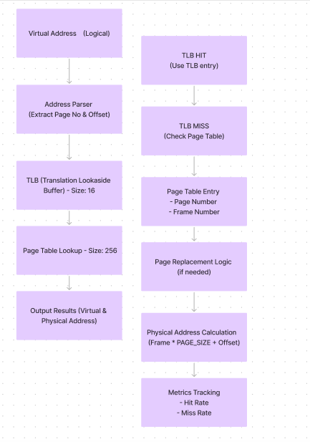
ARCHITECTURE DIAGRAM

Slide 6
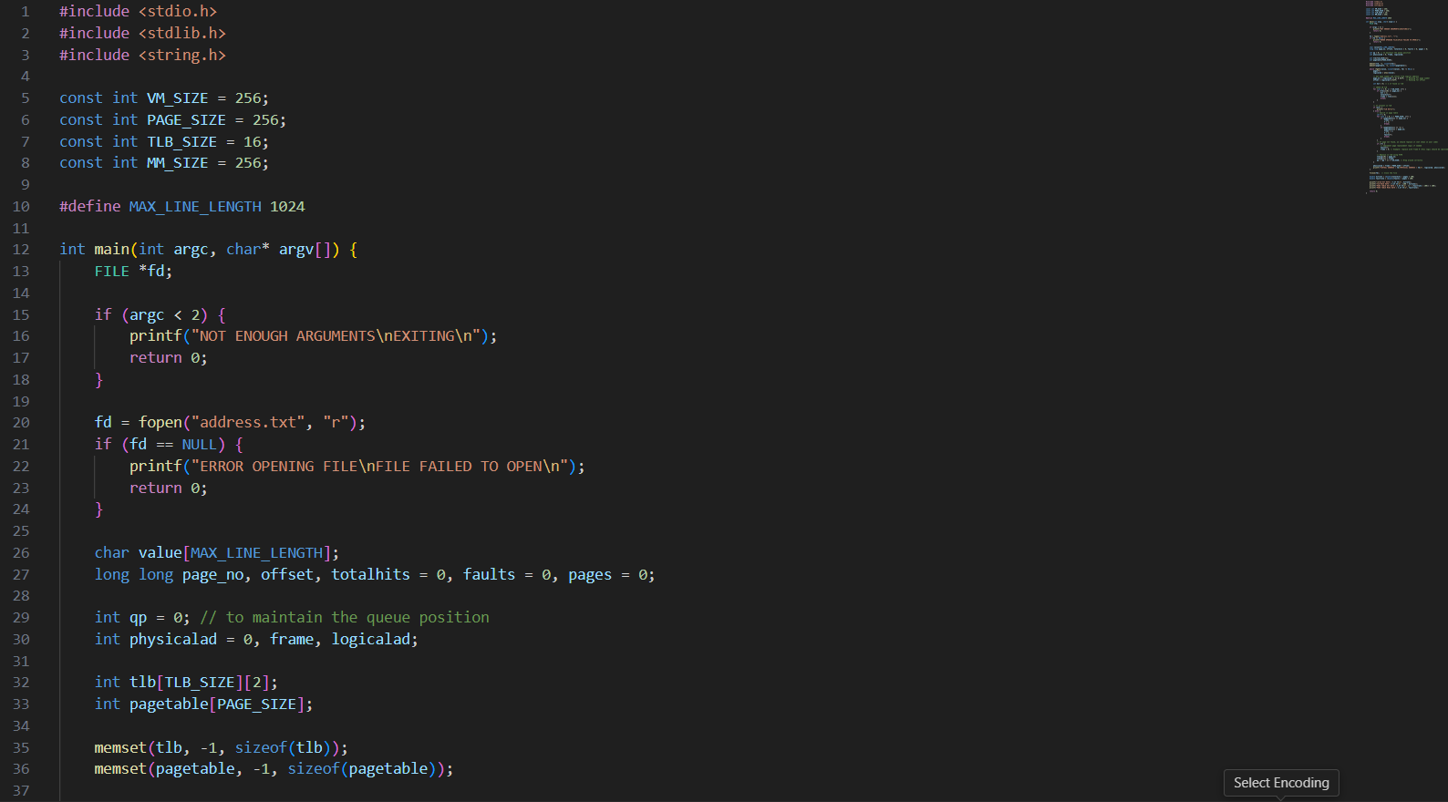
CODE SNIPPETS

Slide 7
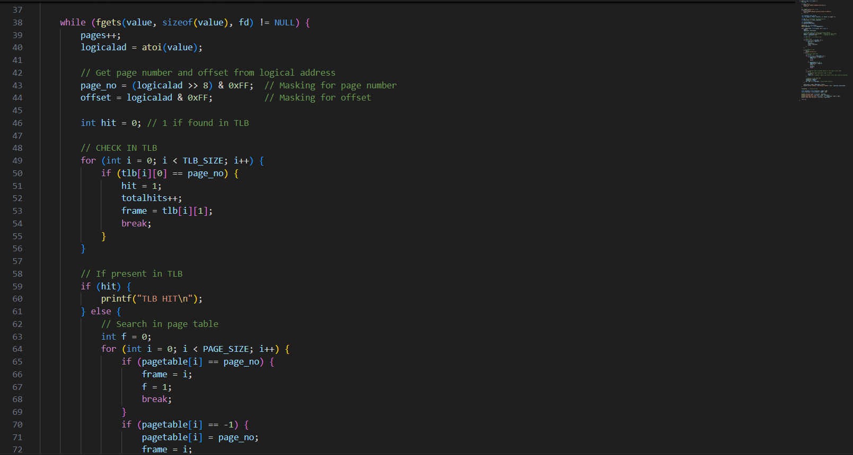

Slide 8
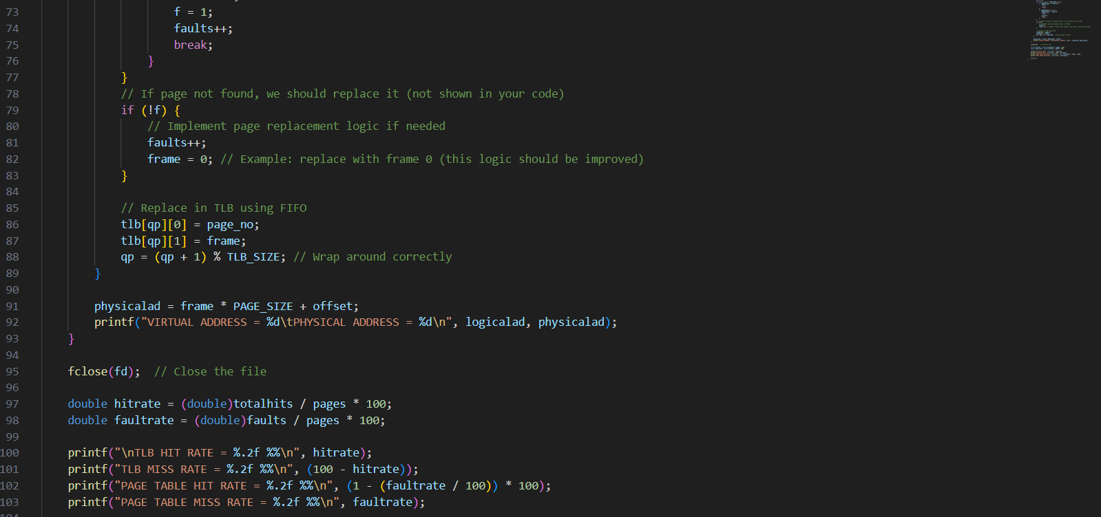

Slide 9
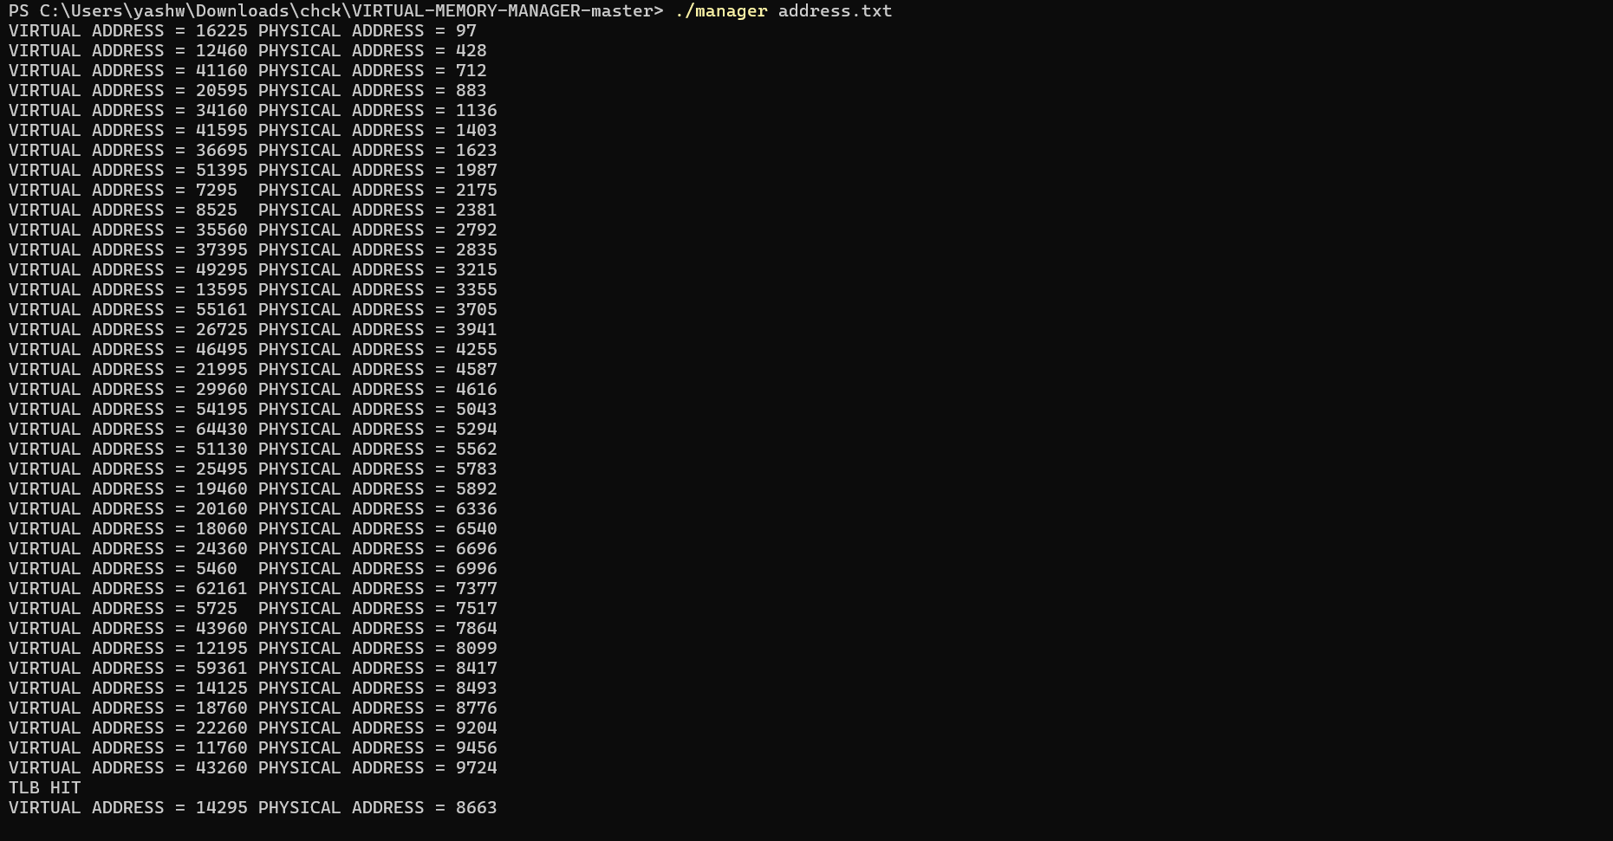
OUTPUT

Slide 10
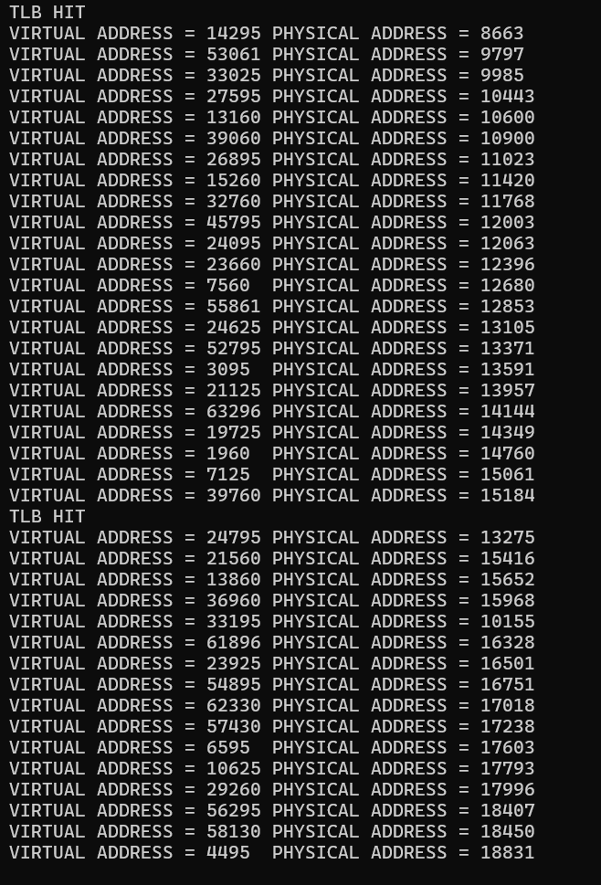
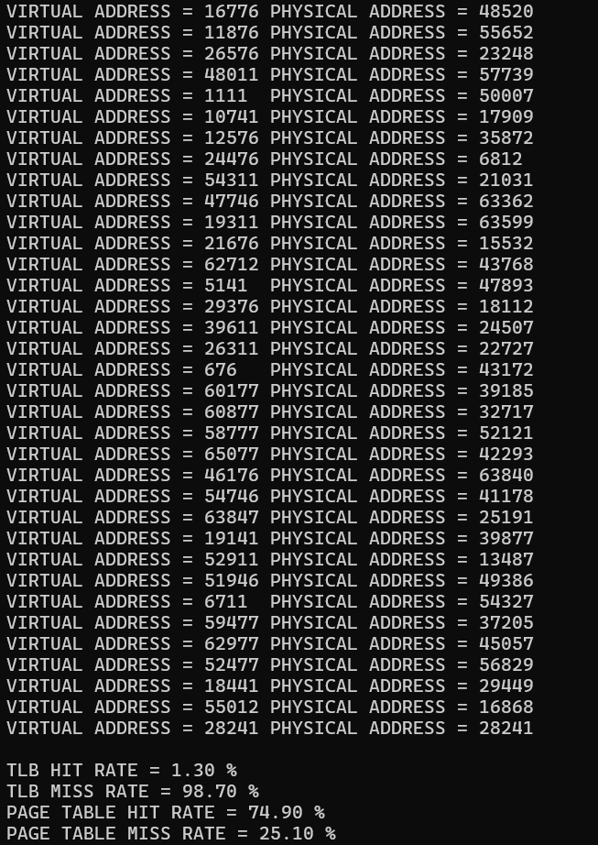

Slide 11
CONCLUSION
In this project, we successfully developed a virtual memory manager that simulates the translation of logical addresses to physical addresses using a Translation Lookaside Buffer (TLB) and a page table. The implementation demonstrated the core concepts of virtual memory management, including address translation, caching strategies, and performance metrics.

